Slide 1


Website of the Grocery Store Chain
Experimental Design and A/B Testing
pacmann.io
© 2022 – Pacmann AI

Slide 2
Outline
Introduction/Background
Setting Up Problem
Designing Experiments
Analyzing and Interpreting the Data
Conclusion and Recommendation
References

Slide 3
Introduction/Background
Notes:
Transisi antar outline

Slide 4
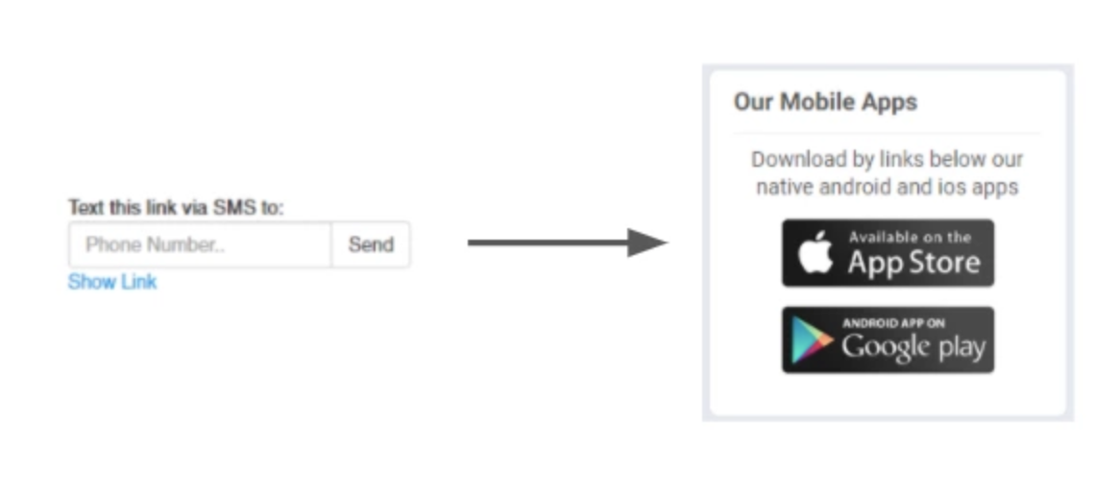
Introduction
There is a large grocery chain. The company’s goal is to drive more customers to download the mobile app and register for the loyalty program. The manager is curious if changing the link to a button of the app store will improve the user’s ability to download the app. Here is the existing link button of the app store.
The manager asked to create an A/B testing plan for changing the link to a button of the app store with the expectation it will the user’s interest to download the app.

Slide 5
Setting Up Problem
Notes:
Transisi antar outline

Slide 6
Setting Up Problem
Experiment Goal
To see if changes to the link to a button of the app store can increase user interest in downloading the mobile application.
2. Choosing Metrics
Goal Metrics : User Counts
- Represents the company’s purpose or core business.
Objective : Drive more customers to download our mobile app and register for the loyalty program.
Reason : User counts can measure how many interested customers have downloaded the mobile app on their devices.
- Simple to communicate with stakeholders.
Stakeholder : Internal team, manager, executives.
Reason : When using this metric, stakeholders can understand how far the mission/goal has been achieved.

Slide 7
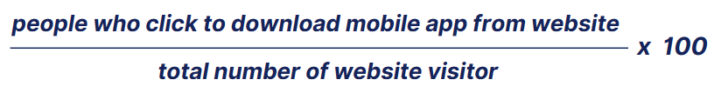
Setting Up Problem
Driver Metrics : Click-Through-Rate (CTR)
- Reason : This metric measures how many customers download the mobile application and sign up for the loyalty program on the link.
Guardrail Metrics : Mobile app loading time
- Reason : If mobile app loading time increases a few ms -> decreased satisfaction -> abandon/uninstall mobile app -> lose users -> potential loss.

Slide 8
Setting Up Problem
3. Define Variants
Control : Existing link.
Treatment : New link, such as in picture not text.
4. Define Hypothesis
H0 (Null Hypothesis) : CTR New link such as in the picture, not text equal to or less than the existing link.
H1 (Alternative Hypothesis) : CTR New link such as in the picture, not text more than the existing link.

Slide 9
Designing Experiments
Notes:
Transisi antar outline

Slide 10
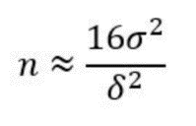
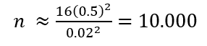
Designing Experiments
Randomization Unit : User
Target of Randomization Unit : All users who visit the web pages of the grocery store chain that contain links
Sample Size :
a. Significance level (α) = 5% or 0.05
b. Power level (1-β) = 80% or 0.8
c. Standard deviation of population (σ) = 0.5
d. Difference between control and treatment (δ) = 2%
Then the number of Sample Size :
Sample size 10.000 for 1 variant, so total for 2 variants : 10.000 x 2 = 20.000

Slide 11
Designing Experiments
e. Since this experiment requires a very large sample size, the length of time to run the experiment depends on the number of visitors to the website.
If the experiment is run for 6 full weeks with the frequency of users visiting the website at least 500 times per day, then the total number of users involved in the experiment is 42 days x 500 = 21,000.
From this, the time sufficient to collect data is at least 6-8 weeks, the length of this experiment is done to avoid primacy and novelty effects.

Slide 12
Analyzing and Interpreting the Data
Notes:
Transisi antar outline

Slide 13
Analyzing and Interpreting the Data
The dataset used in this project comes from Grocery website data for AB test. The dataset has 184.588 records with 5 variables. Here is information from the data variables used:
- RecordID : identifier of the row of data.
- IP Address : address of the user, who is visiting website.
- LoggedInFlag : 1 - when user has an account and logged in.
- ServerID : one of the servers user was routed through.
- VisitPageFlag : 1 - when user clicked on the loyalty program page.
From the sample size calculation, 10,000 users are obtained for each variant. Therefore, Simple Random Sampling is carried out to get a sample. To analyze and interpret data, the following steps were taken :

Slide 14
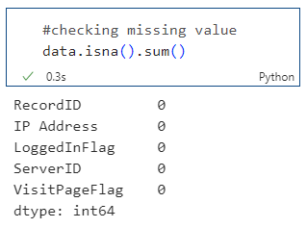
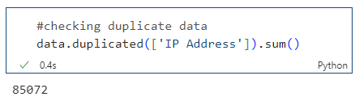
Analyzing and Interpreting the Data
1. Ensure the trustworthiness
a. Check the data quality (missing value, duplicate data, distribution of data).
There is no missing value. Next, check for duplicate data.

Slide 15
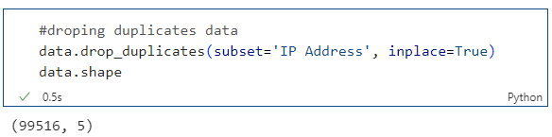
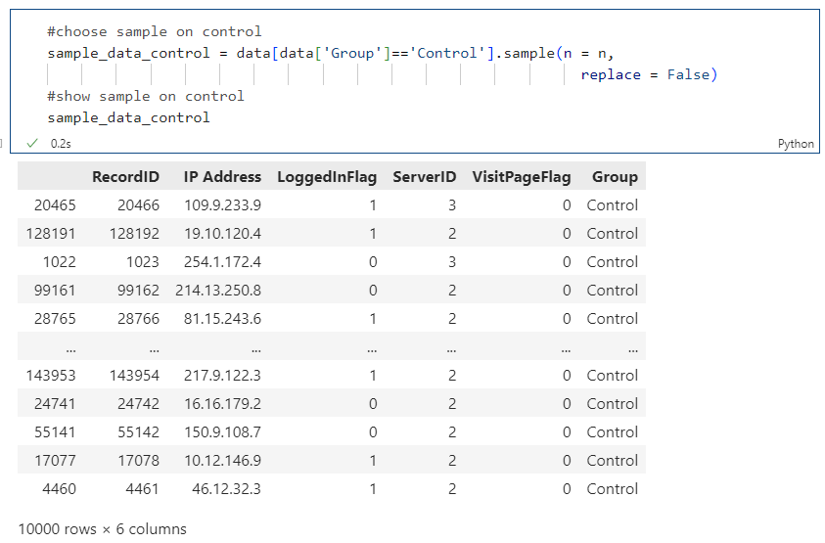
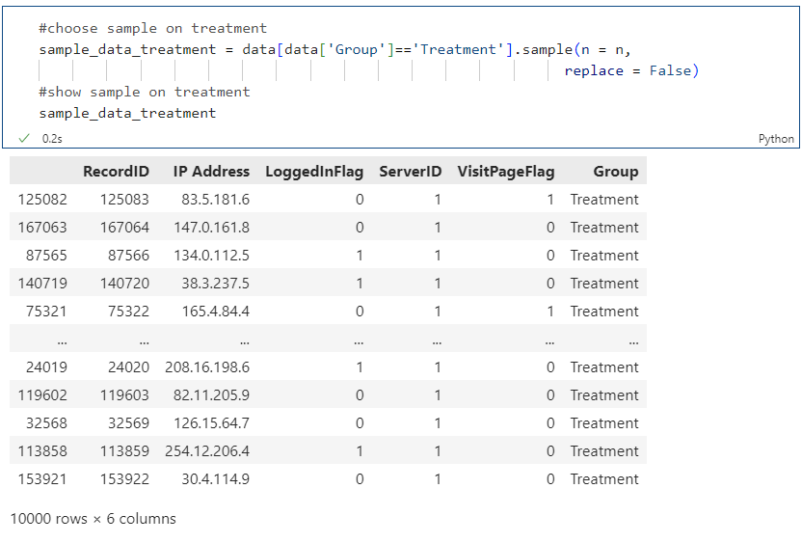
Analyzing and Interpreting the Data
There are 85,072 duplicate data, so delete the duplicate data.
Now, there are 99.516 total records without duplicates and the data is ready for analysis.
b. Data exploration (how many users in each group, and other insight from dataset)

Slide 16
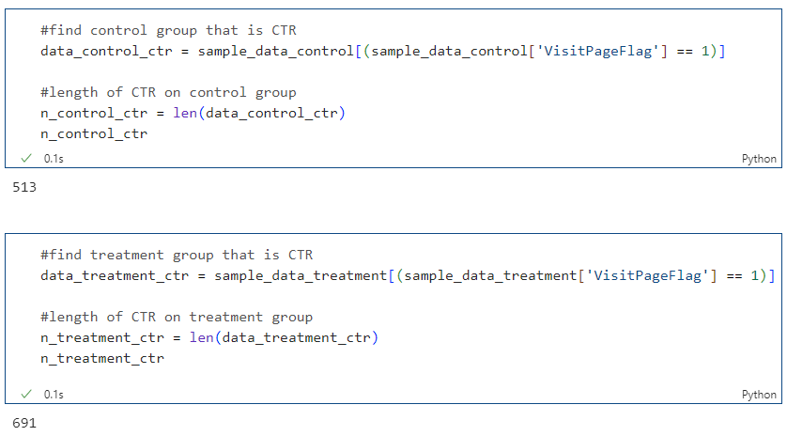
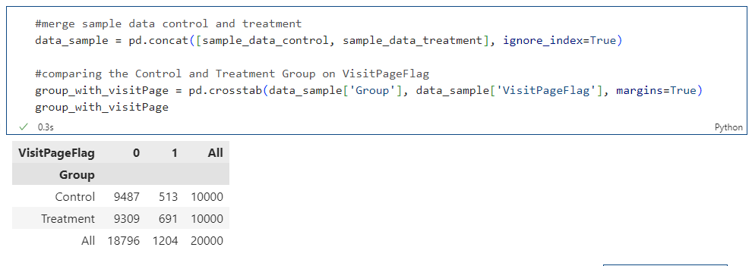
Analyzing and Interpreting the Data
Then calculate the CTR, for both groups as follows.
To see more clearly, compare the control group and the treatment group. Create the following code.

Slide 17
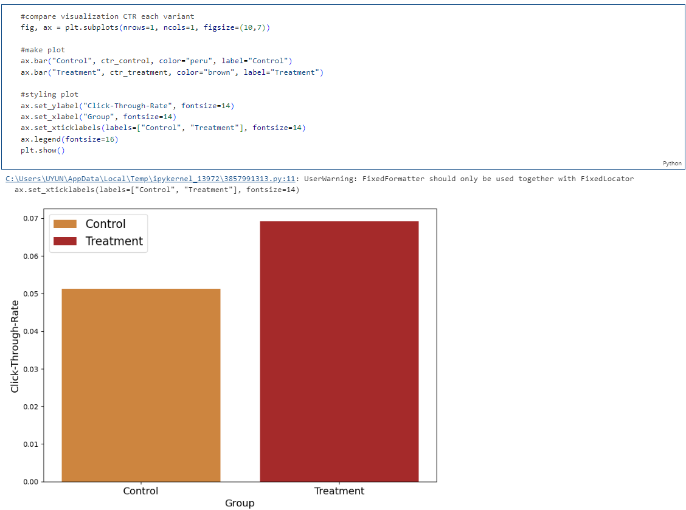
Analyzing and Interpreting the Data
Next make a visualization, to see the comparison of CTR on each variant.

Slide 18
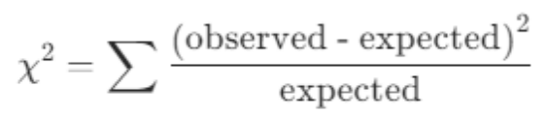
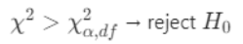
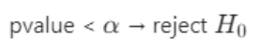
Analyzing and Interpreting the Data
Perform SRM test with chi-square test
- Define the null and alternative hypothesis (H0 and H1)
H0 : No SRM detected
H1 : SRM detected
- Calculate chi-square statistic
- Define decision rules
In making statical test decision, use :
- Comparison of chi-square statistics with critical value
- Comparion of p-value with alpha
- Degree of freedom (df) is calculated as :

Slide 19
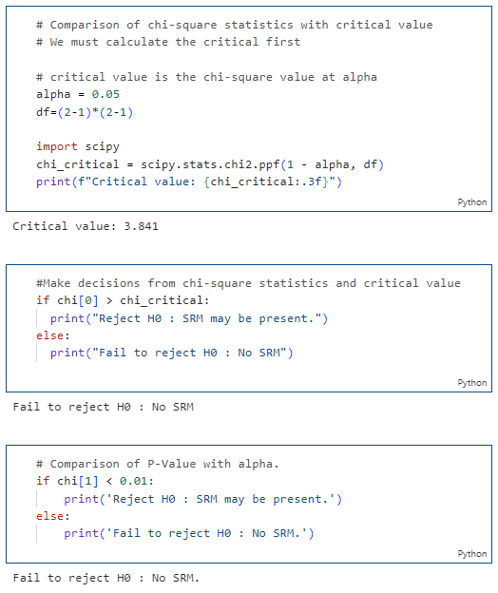
Analyzing and Interpreting the Data
Based on the detection of SRM,
SRM was not detected.

Slide 20
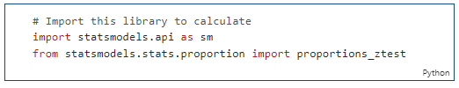
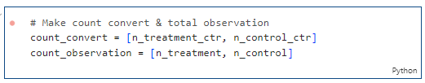
Analyzing and Interpreting the Data
2. Conduct hypothesis testing and analyze the result
- Define null hypothesis H0 and alternative hypothesis H1
H0 (Null Hypothesis) : CTR New link, such as in picture not text ≤ existing link
H1 (Alternative Hypothesis) : CTR New link, such as in picture not text > existing link
First, define Zcrit, Zstatistic, and p-value. To calculate Zstatistic and p-value use this function.

Slide 21
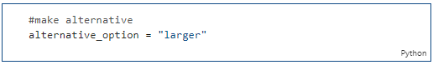
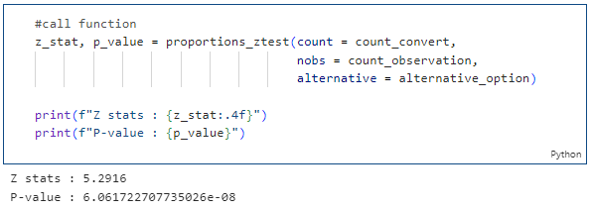
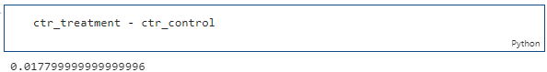
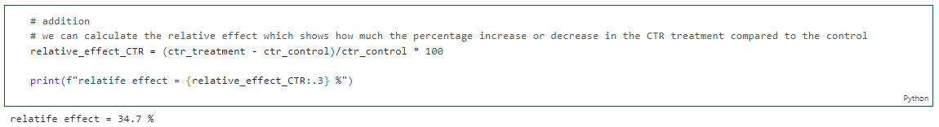
Analyzing and Interpreting the Data
Create an alternative for this hypothesis test case, in this case use ‘larger’ because want to prove CRnew is greater than CRold.

Slide 22
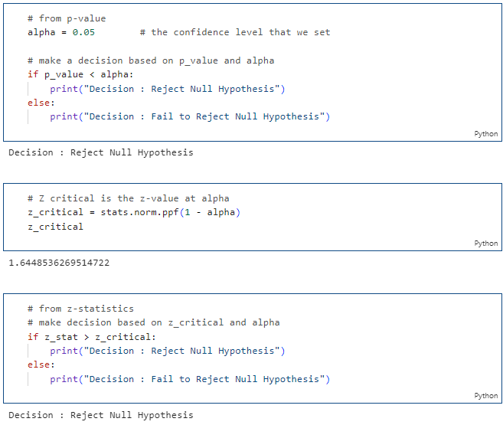
Analyzing and Interpreting the Data
There is a relative increase of 34.7%. Next, summarize the statistical test results.

Slide 23
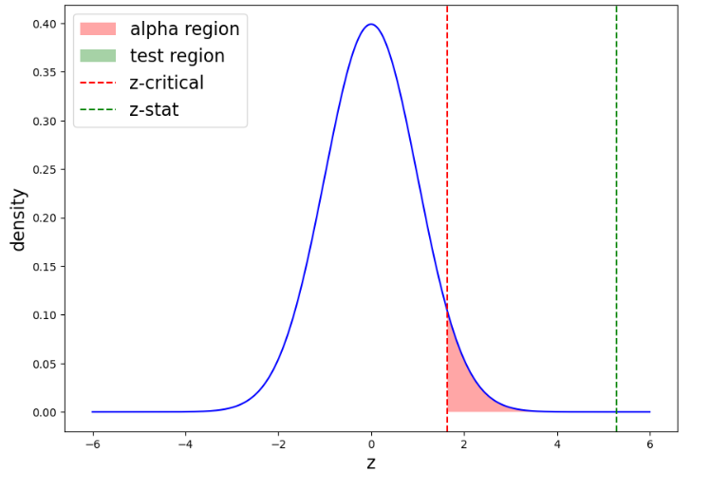
Analyzing and Interpreting the Data
Next, visualize the statistical test results above. The visualization is made in a z value distribution graph. Therefore, find the z value when alpha = 0.05. The results of the visualization obtained will be seen in the following figure.

Slide 24
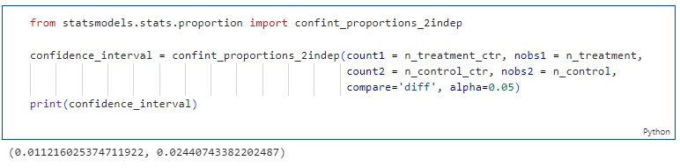
Analyzing and Interpreting the Data
3. Calculate confidence interval of difference between treatment and control

Slide 25
Conclusion and Recommendation
Notes:
Transisi antar outline

Slide 26
Conclusion
P-value (6.061722707735026e-08) < α (0.05) -> Reject H0
Z Statistic (5.2916) > Z Critical (1.644) -> Reject H0
With significance level 5%, there is sufficient evidence that CTR New link such as in picture not text (treatment) more than existing link (control). In other words, CTR New link, such as in picture not text will increase user interest in downloading the application.
Recommendations for website of the grocery store chain :
Based on the statistical test results, the results are statistically significant. P-value = 0.05 indicates that there is a 5% probability that the observed difference is due to chance or other factors unrelated to the variable being observed.

Slide 27
Conclusion
But to make a decision whether to change the link to a button of the app store or not, must be practically significant such as :
Resources and costs required to implement the change. If the cost required for the change to the link to a button of the app store on the website is very high and not proportional to the impact on mobile app downloads, then the change may not be considered practically significant.
It is also necessary to consider the difference between performance before and after the change. If the change to the link to a button of the app store on the website can increase mobile app downloads by 1% or more, then the change may be considered practically significant. However, if the change only increases mobile app downloads by 0.1% or less, then the change may not be considered practically significant.
Based on the above considerations, the change is considered practically significant.

Slide 28
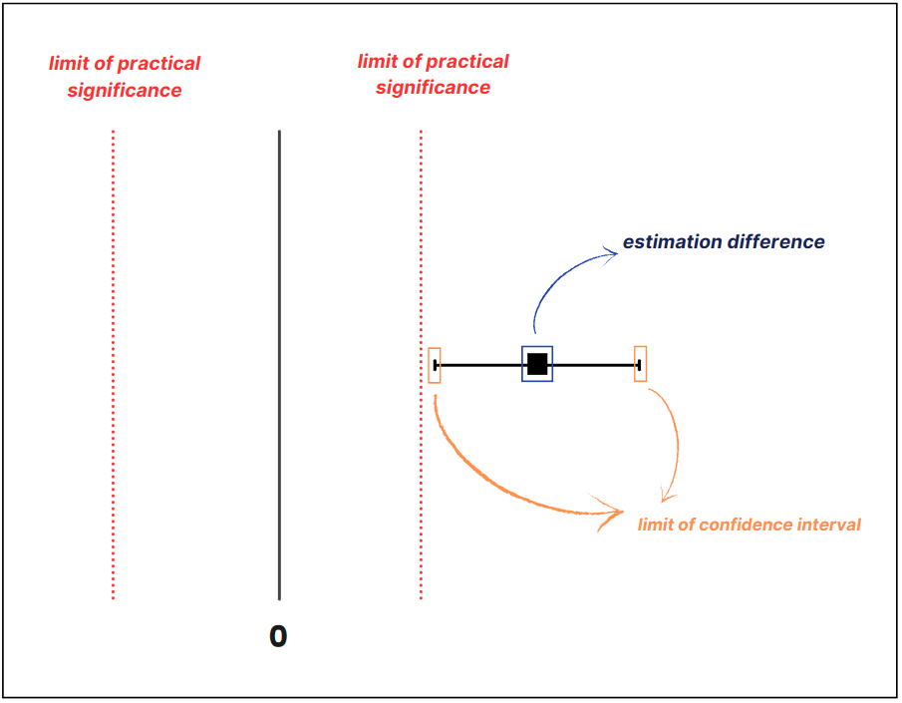
Conclusion
Launch Feature :

Slide 29
Recommendation
Download page variants: change the layout or content of the mobile app download page, such as adding images or positive reviews from other users.
App description: Change the app description on the website, such as highlighting the benefits or advantages of the app.
Changes to the overall appearance and content of the website: Changing the overall layout, design, and content of the website can affect the way users interact with the website.
Target audience: There may be certain groups of users who are more likely to download apps than others, so changing the look and content of the website to appeal more to certain target groups could be a recommendation for future experiments.

Slide 30
Reference
mobileappdaily.com, Top 8 App Engagement Metrics For Mobile Apps To Track in 2023. March 14, 2023. [Accessed on April 1, 2023]. https://www.mobileappdaily.com/top-metrics-to-measure-user-engagement.
Damaševiˇcius Robertas, Zailskaite-Jakšte Ligita. Usability and Security Testing of Online Links: A Framework for Click-Through Rate Prediction Using Deep Learning, 2022.
storyly.io, App Loading. [Accessed on April 1, 2023]. https://www.storyly.io/glossary/app-loading.
Festing Michael FW. On determining sample size in experiments involving laboratory animals, 2017.
Khanacademy.org, Population standard deviation. [Accessed on April 1, 2023]. https://www.khanacademy.org/math/statistics-probability/summarizing-quantitative-data/variance-standard-deviation-population/v/population-standard-deviation#:~:text=The%20population%20standard%20deviation%20is,data%20is%20from%20its%20mean.
dimewiki.worldbank.org, Minimum Detectable Effect. [Accessed on April 9, 2023]. https://dimewiki.worldbank.org/Minimum_Detectable_Effect#:~:text=The%20minimum%20detectable%20effect%20is,and%20survey%20and%20project%20budgets.

Slide 31
Thank You
Notes:
Transisi antar outline

